Slide 1
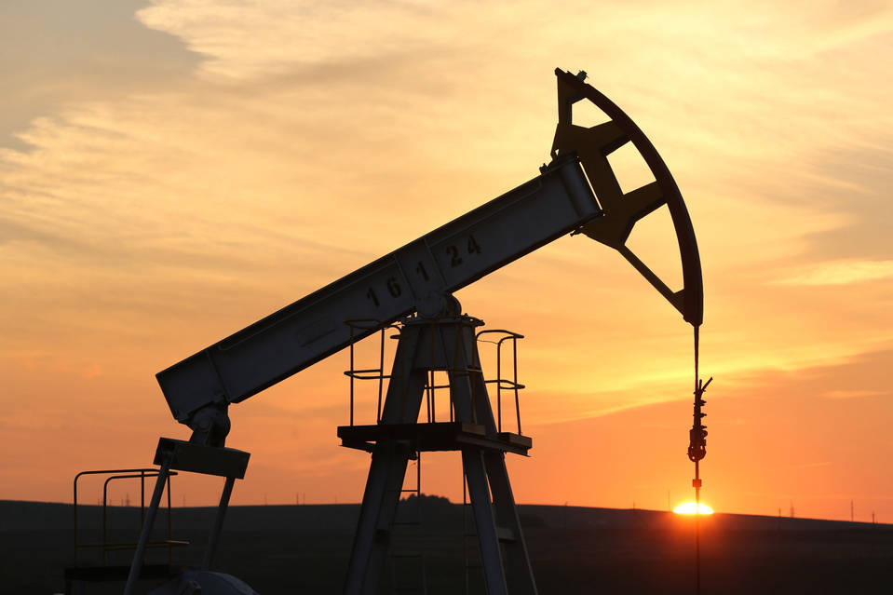
Impact of Sentiment Analysis on Oil & Gas Companies
By- GAMR (team#4)

Slide 2
Project Details
Project Title – Impact of Sentiment Analysis on Oil & Gas companies Stock price
Team Members – George, Alejandron, Manu and Rajat
Project Description/Outline – Project is to understand the impact of Social Sentiments on Oil Companies stocks listed on S&P500 (note: scope is limited to 5-10 Oil companies stocks price analysis)
Research Description/Outline – Aim of the research is to take sample Tweets (unstructured data) and analyze the positive, negative and neutral sentiments as compare to the Oil stocks price. This research will help us understand the correlation between the Sentiments and stock price.
Outcome –
Our Twitter analysis can help,
Investors take intelligent decisions regarding trading (calls/puts) on Oil company stocks
Companies can measure the impact of sentiment on their top line (revenue)

Slide 3
Project Details
Research Questions to Answer – Our research questions,
Q1. Why investors & Oil companies should pay attention to social analytics data?
Q2. How much do Sentiments impact on Oil prices?
Q3. Will investors be able to take smart investment decisions based on historical trends?
Data Sets to be Used –
Tweets & Stock price historical data for last “X” number of days.
Tweets under consideration may be #OPEC, # Brent, #WTI,#CL and US independent Oil and gas companies such as PXD, EOG, Chevron and EXON

Slide 4
Project Details (Contd.)
Rough Breakdown of Tasks –
Collect sample tweets (past couples of days) from Twitter API
Perform IBM Watson Sentiment analysis on Tweets using IBM Natural Language Services
Collect last few days of stocks data of companies from S&P 500
Perform statistical analysis on stocks and tweets and determine correlation
Plot analytical charts
If time permits, perform some predictive analytics

